Slide 1
Movıe tıcket bookıng system
SE318-Software Verification and Validation Course Project

Slide 2
Used Technologies
Java
Eclipse
MongoDB

Slide 3
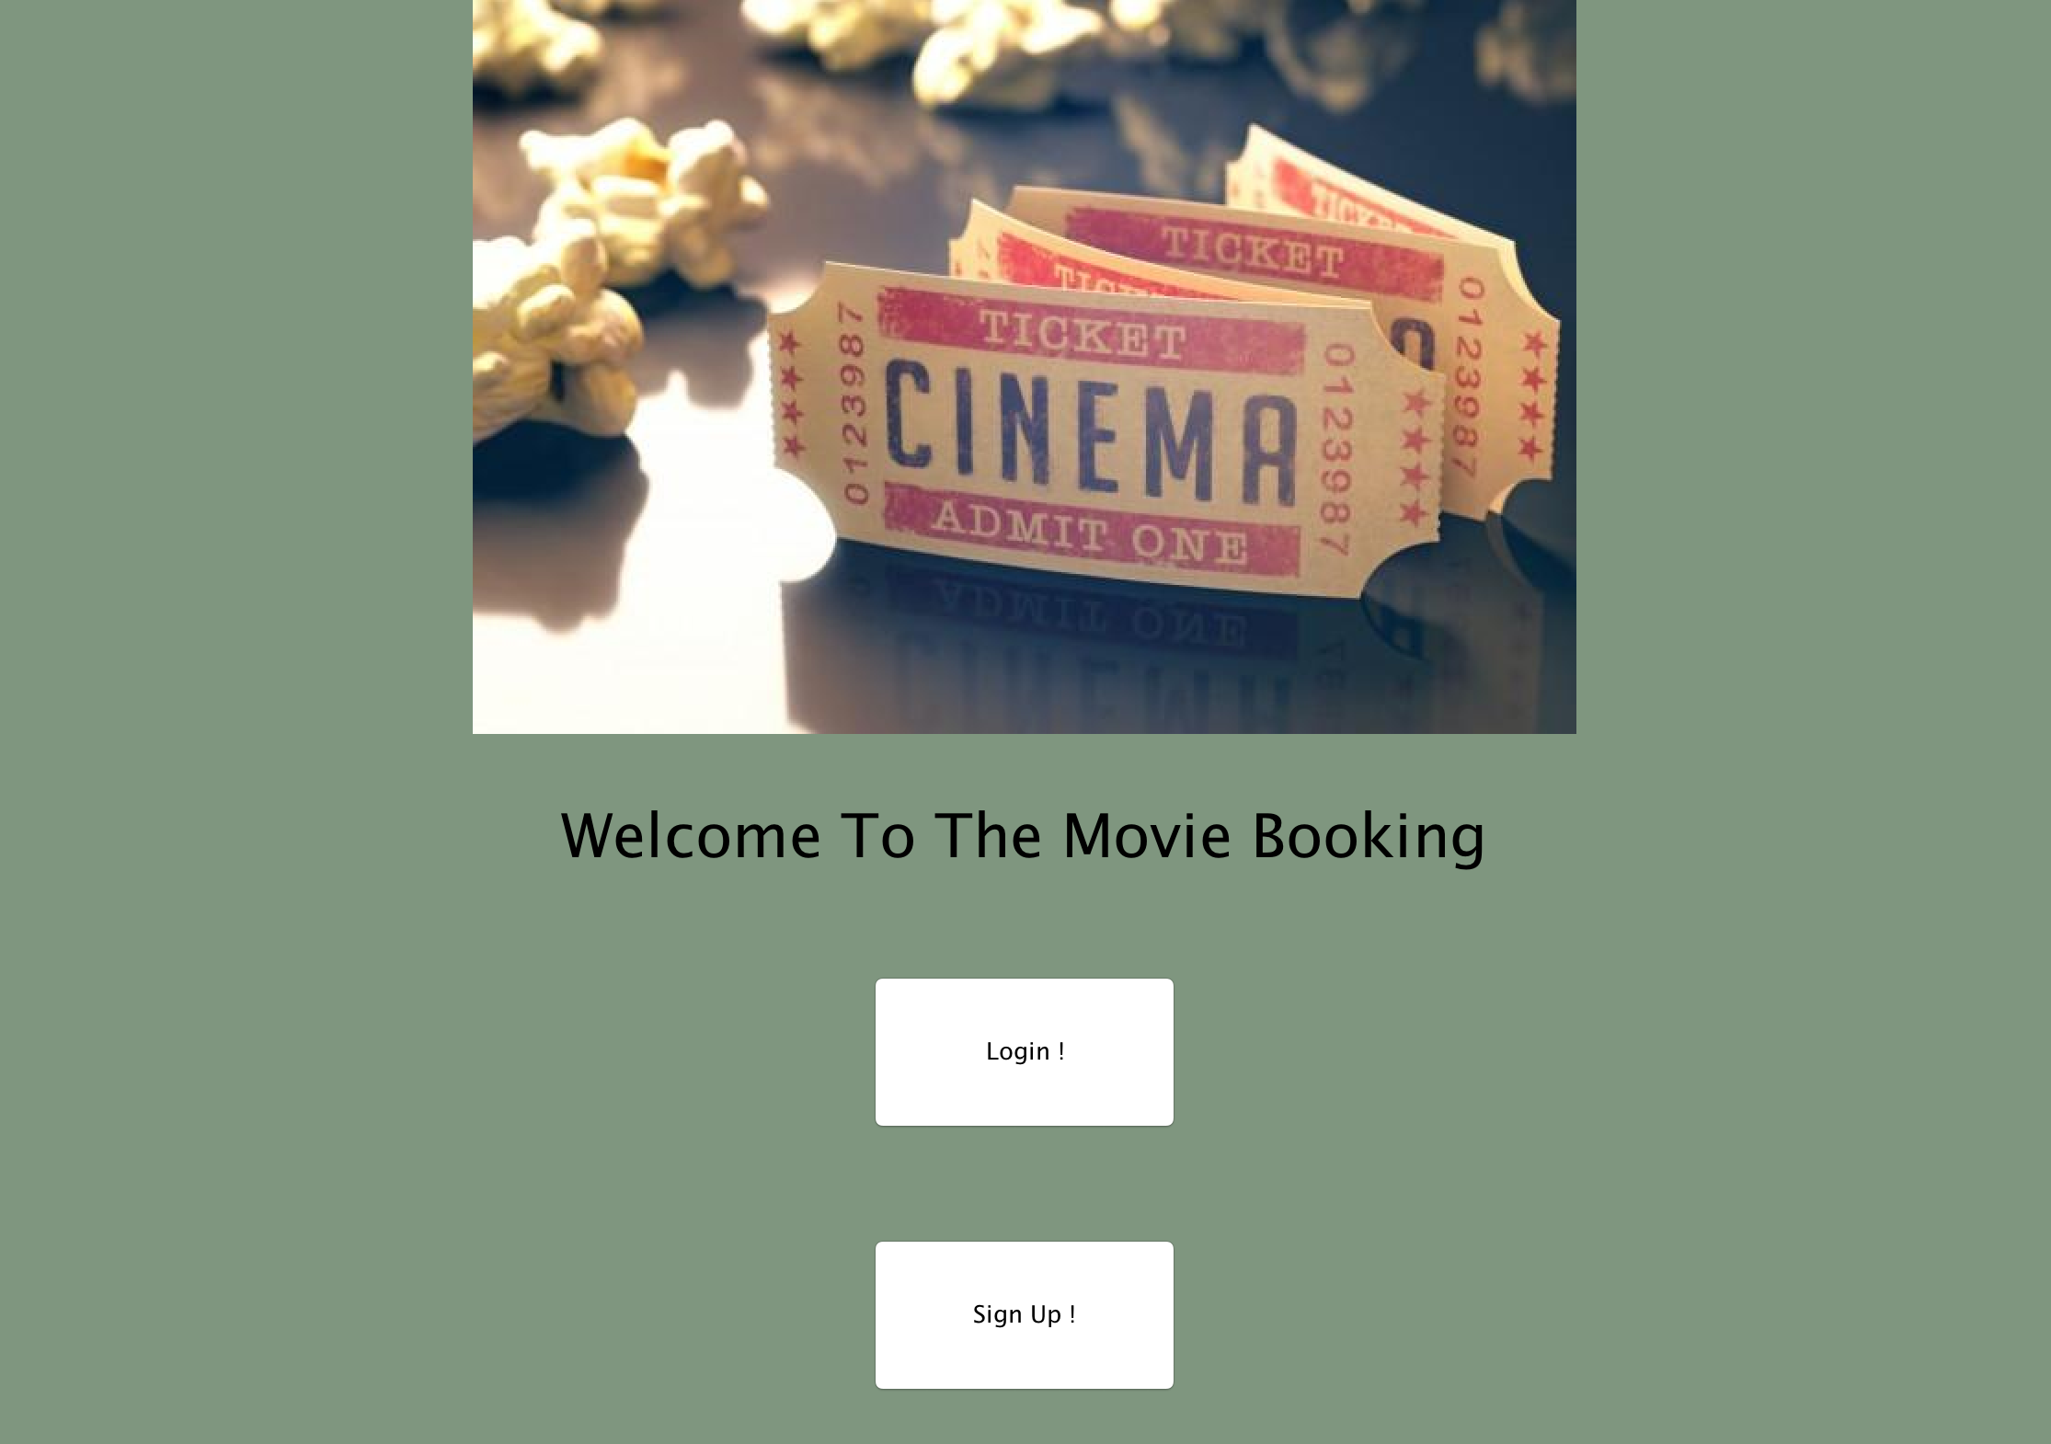
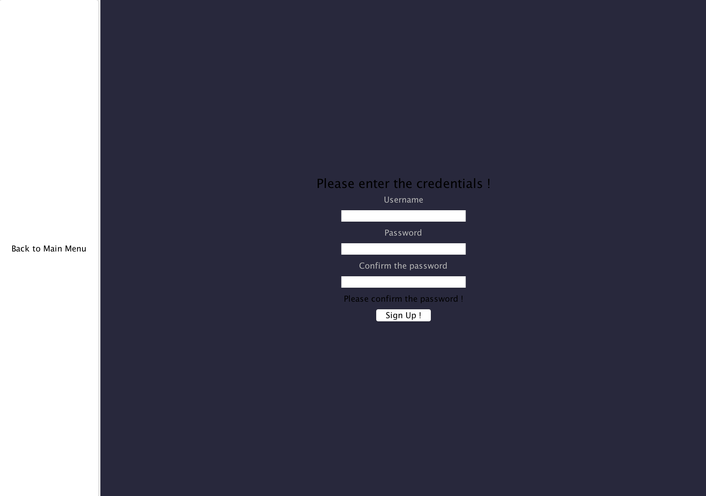
Screenshots

Slide 4
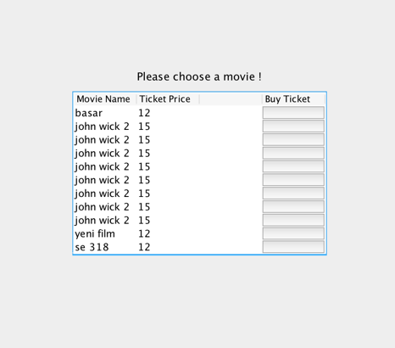
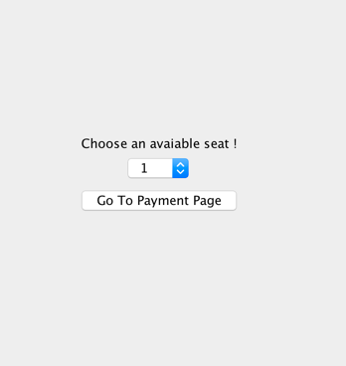
Screenshots

Slide 5
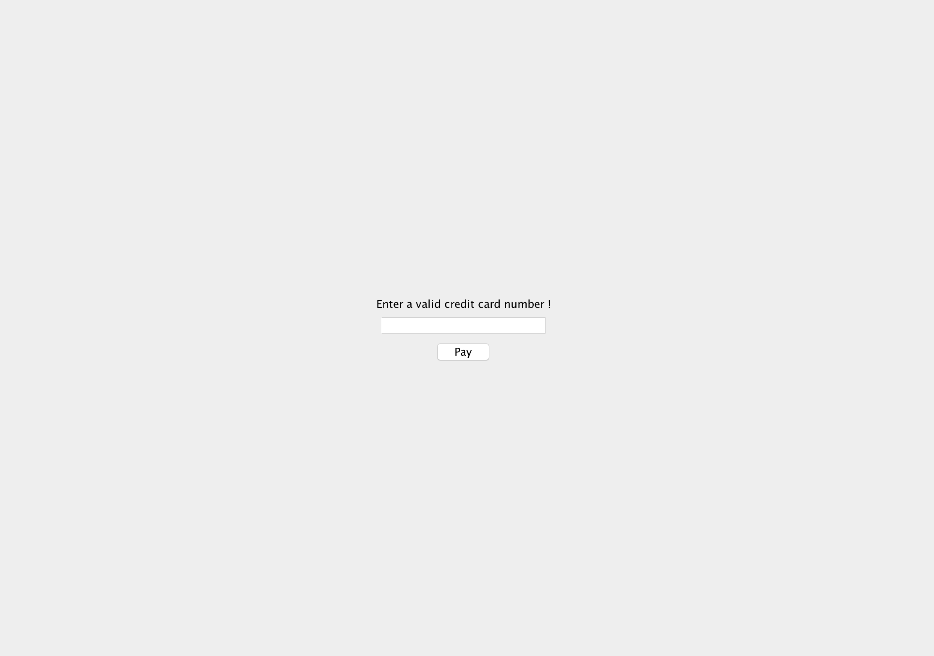
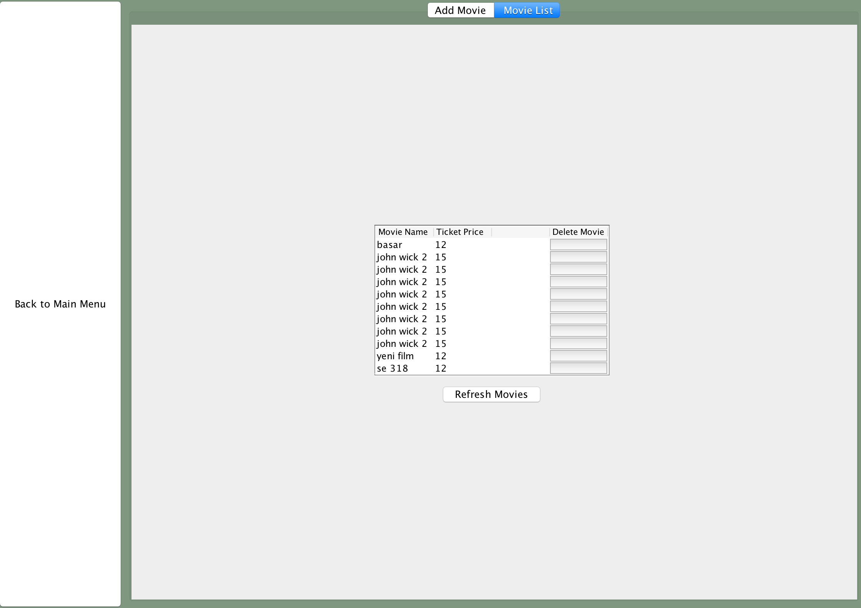
Screenshots

Slide 6
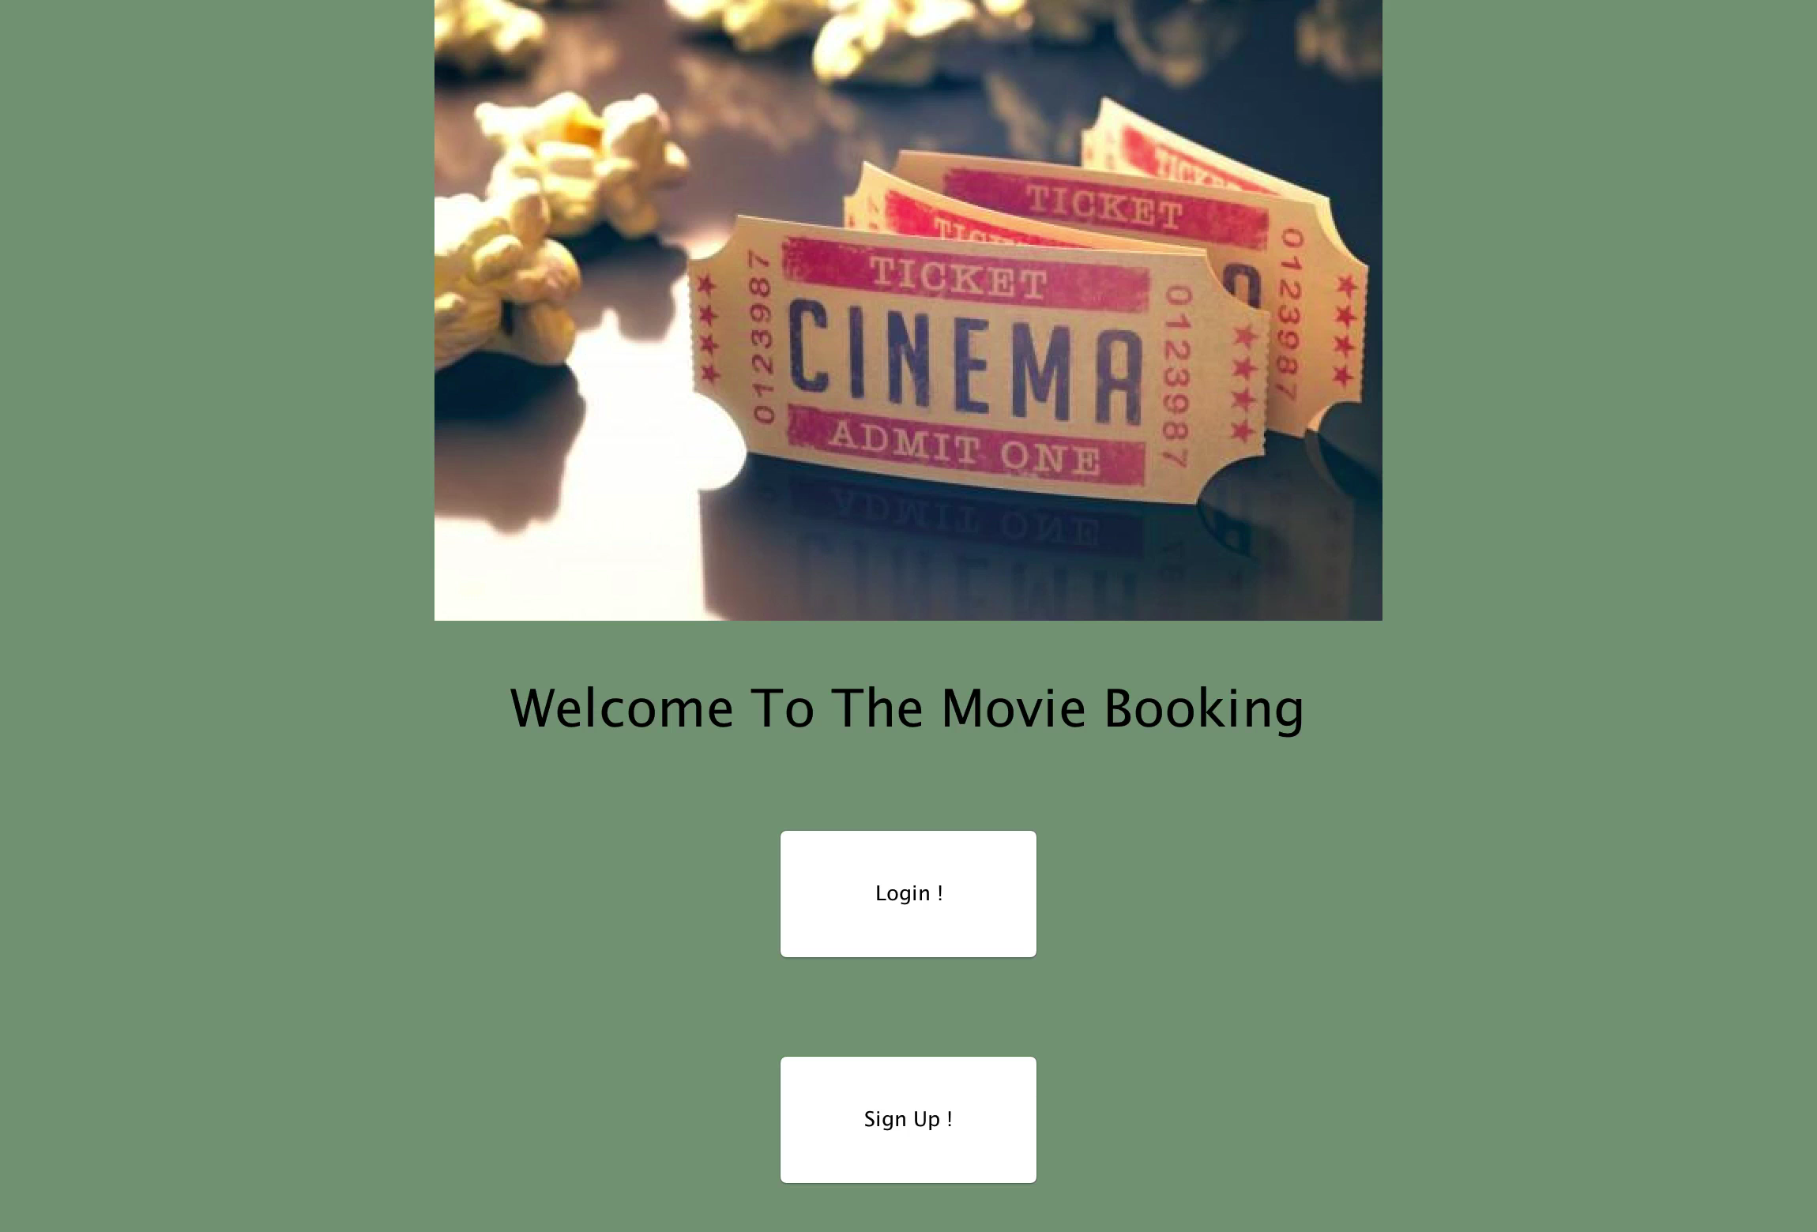
Demonstration Video

Slide 7
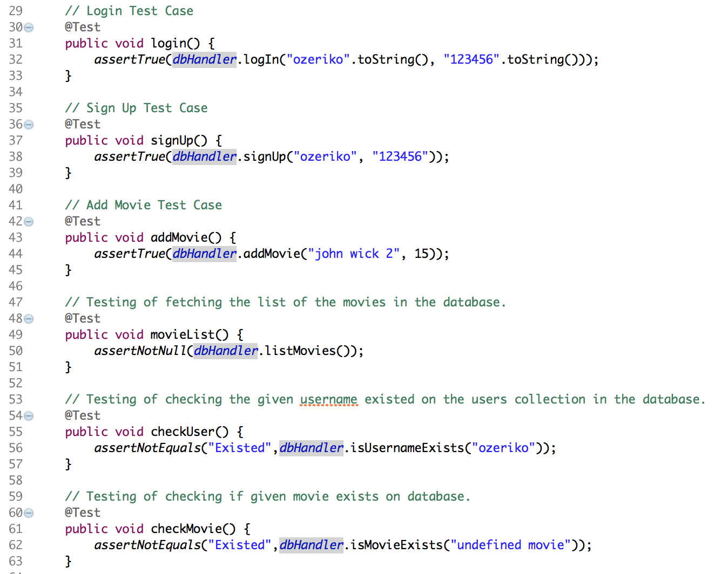
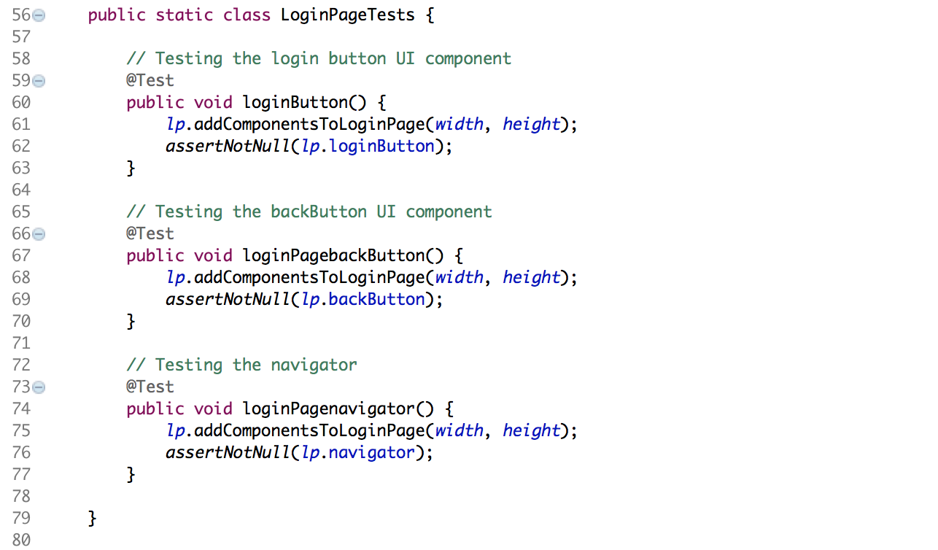
Unit Tests

Slide 8
Thank you
Başarcan Celebci
Özer Çevikaslan
Simge Özcan

